Slide 1
Student Research Zekelman School of IT (DAB)
DAB-402: Group 12

Slide 2
Agenda
Who are all involved?
Team
Stakeholders
Which area we want to explore?
Introduction
Problem Statement
What’s in the Data?
When are we doing it?
Current Progress
Overall Timeline
How are we doing it?
Method and Technology
Where are we heading?
Challenges
Further Steps
Questions

Slide 3






Group #12: Team
Amit Sharma
0794488
Role: Group Leader
Skills: DB Pipelines, Leadership & Cloud
Manjari Maheshwari
Role: Guide and Stakeholder
John Gerassimou
Role: Guide and Data pipeline
Suhail Ahmed
Id: 0789949
Role: BI and Data
Skills: Tableau Dashboard Data Engineering & SQL
Jayraj Radadiya
ID: 0789984
Role: Programming & BI
Skills: Python & Dashboards
Rajvi Mehta
ID: 0788372
Role: Researcher
Skills: Online Search, Data Collections & Data Work
Harshil Patel
ID: 0791261
Role:
Skills: Tableau, Data
Surveys & Communications
3

Slide 4

Stakeholders
The main objective is to collect and conduct a detailed and relational analysis/study of data pertaining to all current students enrolled in the DAB program.
Stakeholders
Streamlined and Comprehensive study for understanding student’s data and concerns.
College
Management
Platform for raising and addressing Student’s concerns regarding Living and Academics
Benefits
Students
Project Team
Work on a problem and learn various technology platforms and understand Data pipelines
4

Slide 5
Introduction
The project aims to improve the student experience at St Clair College's Data Analytics for Business program.
The main objective is to create a centralized system for collecting and utilizing student data and monitor their needs and problems.
Goals include identifying key issues and potential solutions through data analysis and presenting findings through an interactive dashboard.
Another goal is to create a template for other departments to use.
Success will be measured through data accuracy, user feedback, adoption rate, user engagement, and trend analysis.
The project will use primary and secondary data sets, machine learning techniques, and tools like Python and Tableau.

Slide 6
Research Question
St Clair College's Data Analytics for Business program is facing a challenge in effectively analyzing student trends and sentiments
This challenge is due to a lack of a centralized system for collecting and managing student data
The lack of organization is leading to a lack of visibility into student issues
This lack of visibility may result in a lack of satisfaction among students
The project aims to create a centralized system for collecting and utilizing student data
The project also aims to create a mechanism to monitor and understand student needs and their problems
The student needs and problems include challenges related to accommodation, transportation, educational support, the college schedule, health services, and other matters.

Slide 7




What’s in the Data
SURVEY DATA
Demographic
Ease of living
Academics
HOW:
Primary data collection was conducted through surveys.
The collected data is stored in an Excel online file. To automate the transfer of data from Excel to Google Cloud, we used Microsoft Power Automate to connect the data to Google Drive and facilitate the transfer process.
1
WHAT:
Our data collection process consisted of three parts: demographics, ease of living, and academics.
Demographics: collected information about student backgrounds and personal characteristics.
Ease of Living: focused on students' experiences with housing, transportation, and other aspects of student life.
Academics: gathered data on students' academic performance and experiences.
These three parts provided us with a comprehensive overview of students' experiences and feedback.
2
WHY:
To understand student’s opinions, attitudes, and behaviors
To evaluate programs and services
To improve communication and engagement
3
7

Slide 8





Progress (till now)
STEP 8
STEP 7
Data
Pipeline
STEP 6
Survey setup &
Publishing it
ML
Algorithm
STEP 5
Research & study
Initial
DB
setup
Problem
Statement
definition
STEP 4
STEP 3
Data
Assessment
Stakeholder
meeting
STEP 2
STEP 1

Slide 9




Timeline plan
05
https://github.com/JayrajRadadiya/Capstone-Project/tree/main/ProjectPlan
04
Final Dashboard
Survey 2
03
Dashboard 1
Today
ML and Dashboard
06
02
Data Work
& Pipeline Integration
Final Report
Data
Assessment
Dashboard Work
Survey 2
Work
01
Survey 1
Machine Learning
Data work
Business Problem Formulation
Data Collection
Data Pipeline/DB
W1
W2
W3
W4
W1
W2
W3
W4
W1
W2
W3
W4
W1
W2
W3
W4
January2023
February 2023
March 2023
April 2023

Slide 10
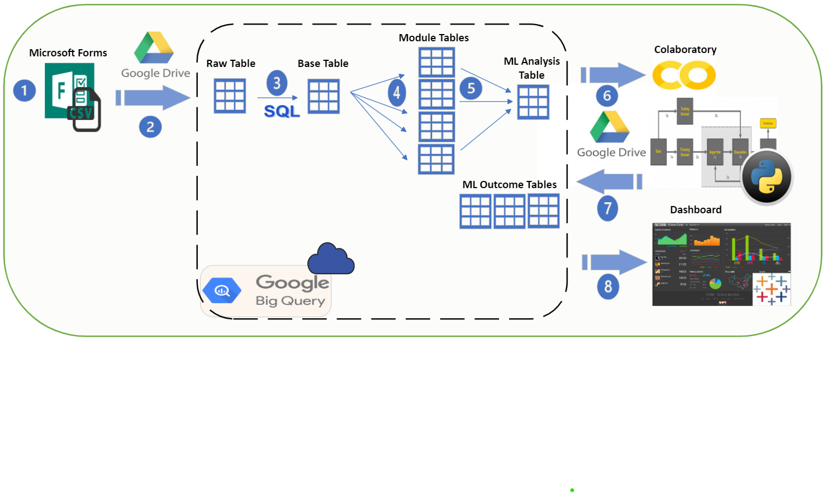
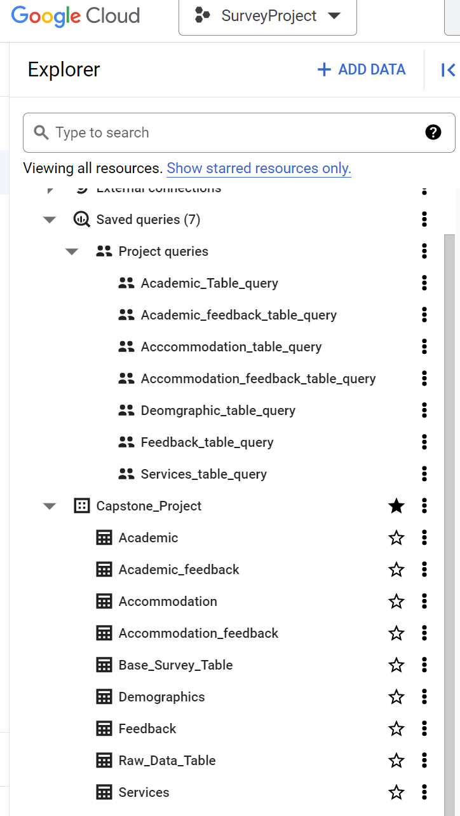








Data Intake Phase - Power Automate
Database Ingestion - .CSV to Big Query (through Drive)
Data Movement – DB architecture (inside the Database)
DB to Google Colab (for ML)
Data Stored back to DB
Data to Dashboard (in Tableau)

Slide 11
Challenges and Solutions
Data Ethics & Collection
As PII Data is involved there is always a challenge
Solution: Used Microsoft Forms to maintain Ethical concerns. No tracking of IDs was allowed as part of survey.
Efforts to advertise the survey through classes and faculty members enabled to obtain more than 60% of the intended data.
Data Engineering
Survey design was intended to be straightforward, but including text field questions has resulted in a data engineering challenges
Solution: Python and SQL Data Cleaning and Standardization
Automation
Manual data flow (for the project) has been defined, but we are exploring ways to automate the process for faster results and one click approach despite the current manual access to active components.
Solution: No Solution yet, Still under consideration
Cloud Pipeline
To understand and implement a Data Pipeline which can work being online (cloud based) and act as a repository for the data
Solution: After thorough research we decided to use Google cloud platform and Big-query

Slide 12
Further Steps & Plan
Phase 1:
Machine Learning Analysis – Phase 1
Data pipeline extension
Dashboard – Stage 1
Phase 2:
Survey 2 – Data collection
Data Work and Analysis
Dashboard – Stage 2
Final Reporting
Timeline: March 2023 and April 2023

Slide 13
Questions/ Feedback
13

